Slide 1
Two Truths and a Lie (AI Edition)
Vevox Quiz: 106-583-269

Slide 2
Neural Networks
Sabeeh Islam (Saf)

Slide 3
Raise your hand if you’ve used ChatGPT

Slide 4

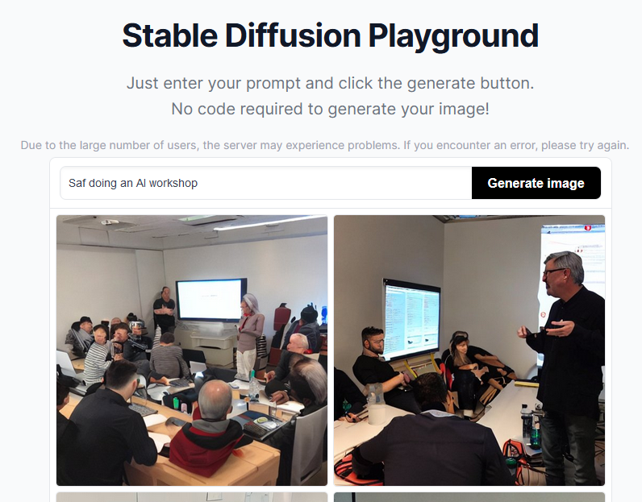
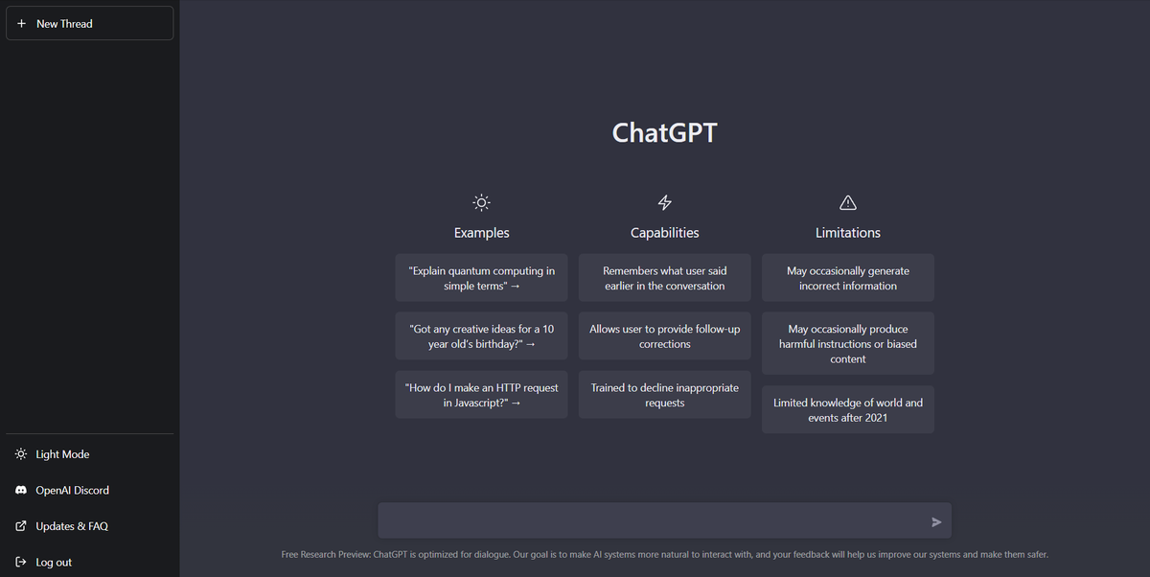
Reaching mainstream popularity

Slide 5
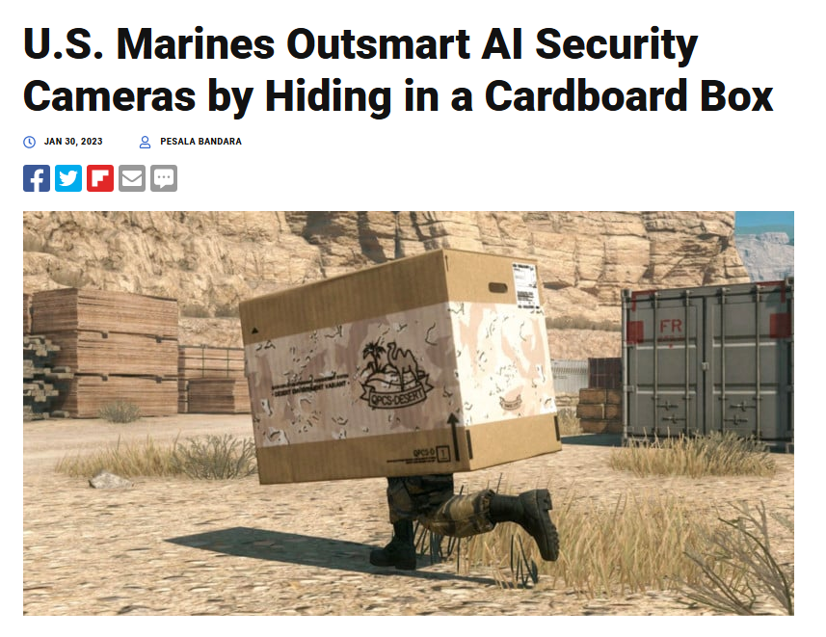

Not so perfect though!

Slide 6
Welcome to our first session!
This session
Articles
Future sessions

Slide 7
The (not fully explored) world of AI

Slide 8
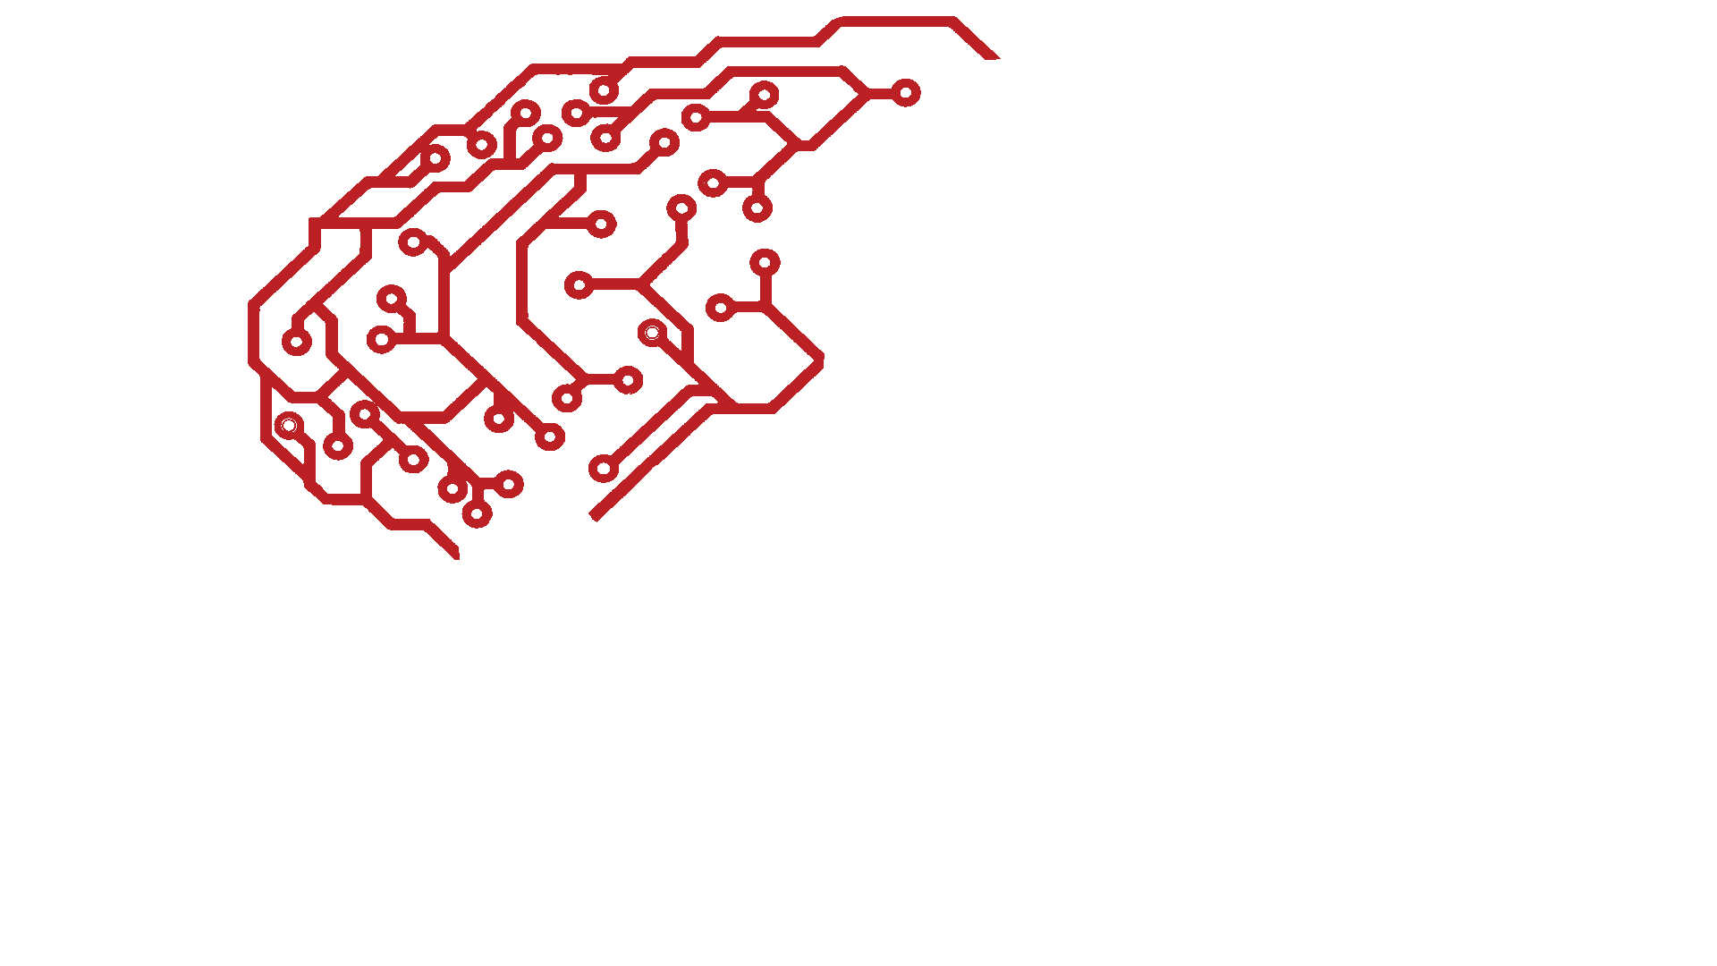
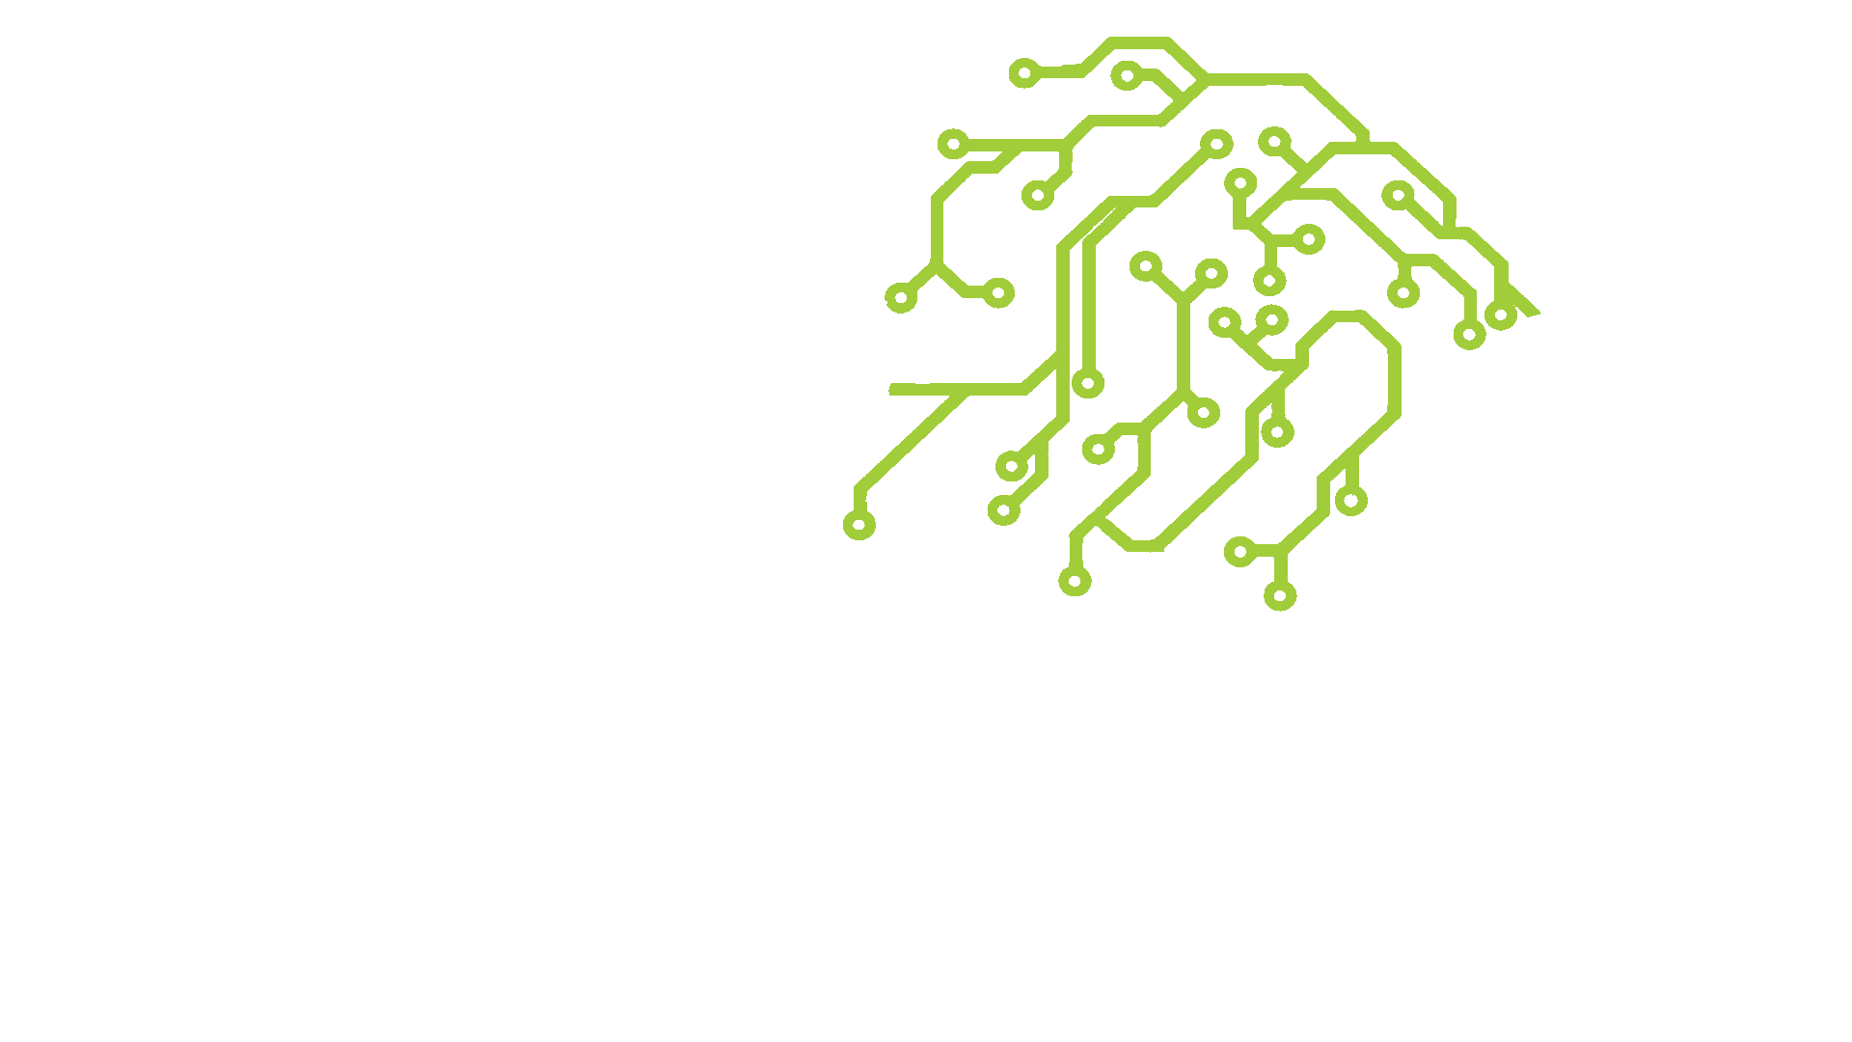



AI Brain
Parietal Lobe: Logistic Regression
Frontal Lobe: Neural Network
Manages high level interactions
Abstraction
Cerebellum: Decision Trees
Brain Stem: Linear Regression
Cerebrocerebellum: Random Forest
By Jakub J. Dylag

Slide 9
Neural Networks

Slide 10
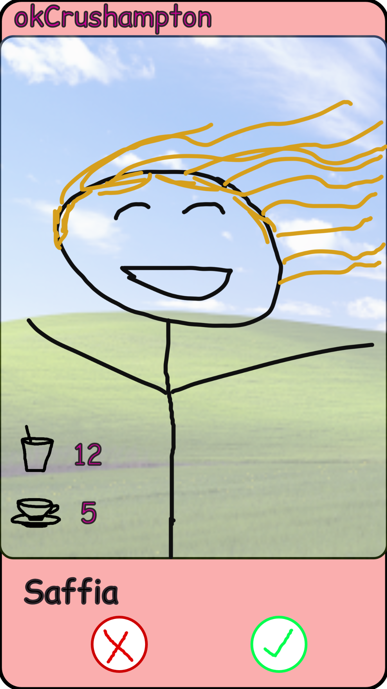

Now let’s think of a problem
Suppose the AI Society (or ECSS) made this brand new dating app “okCrushampton”:
<- Frequency of going club in a month
<- Frequency of going coffee shop in a month

Slide 11
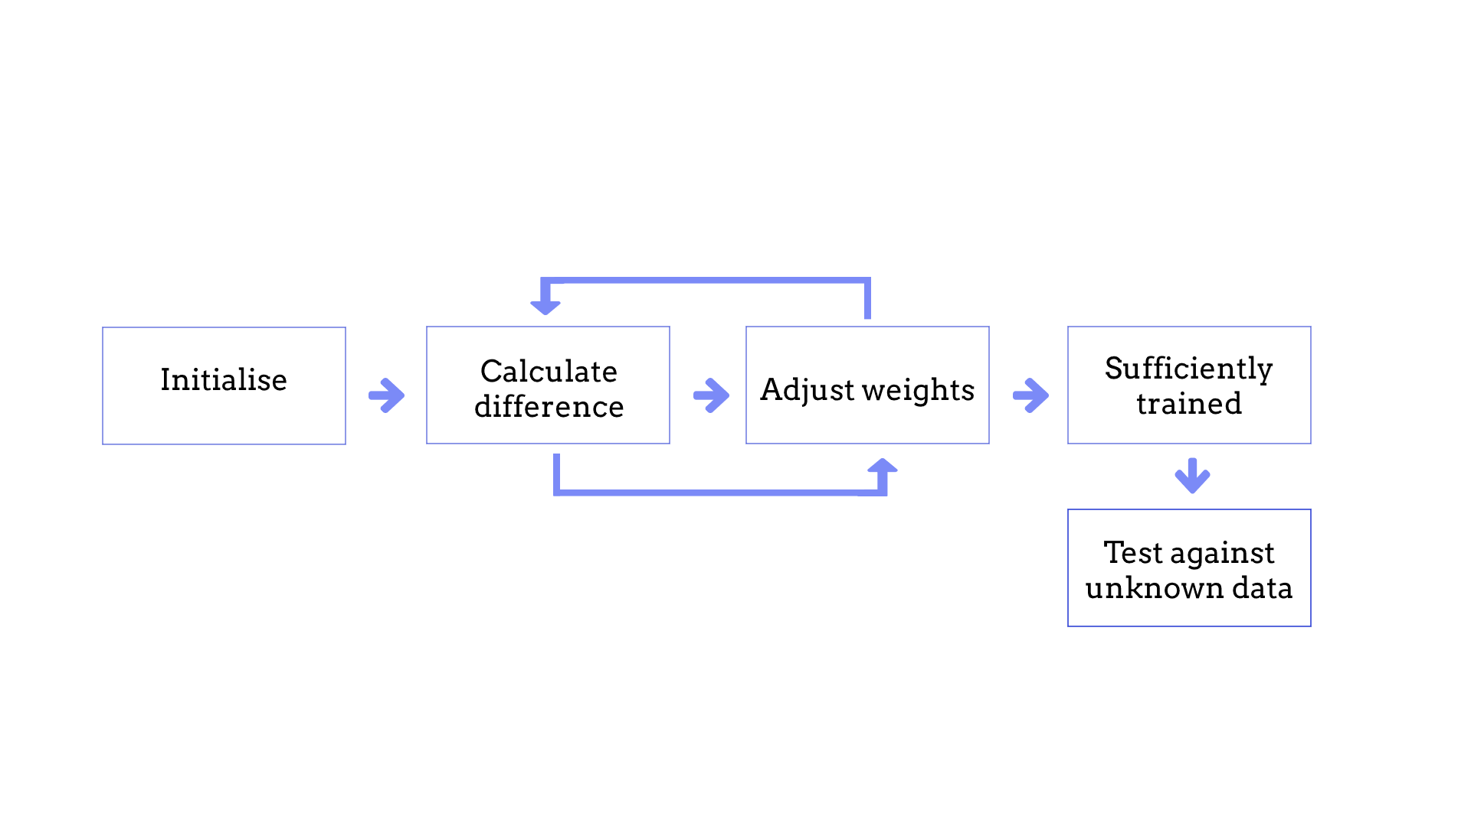
A simplified overview

Slide 12
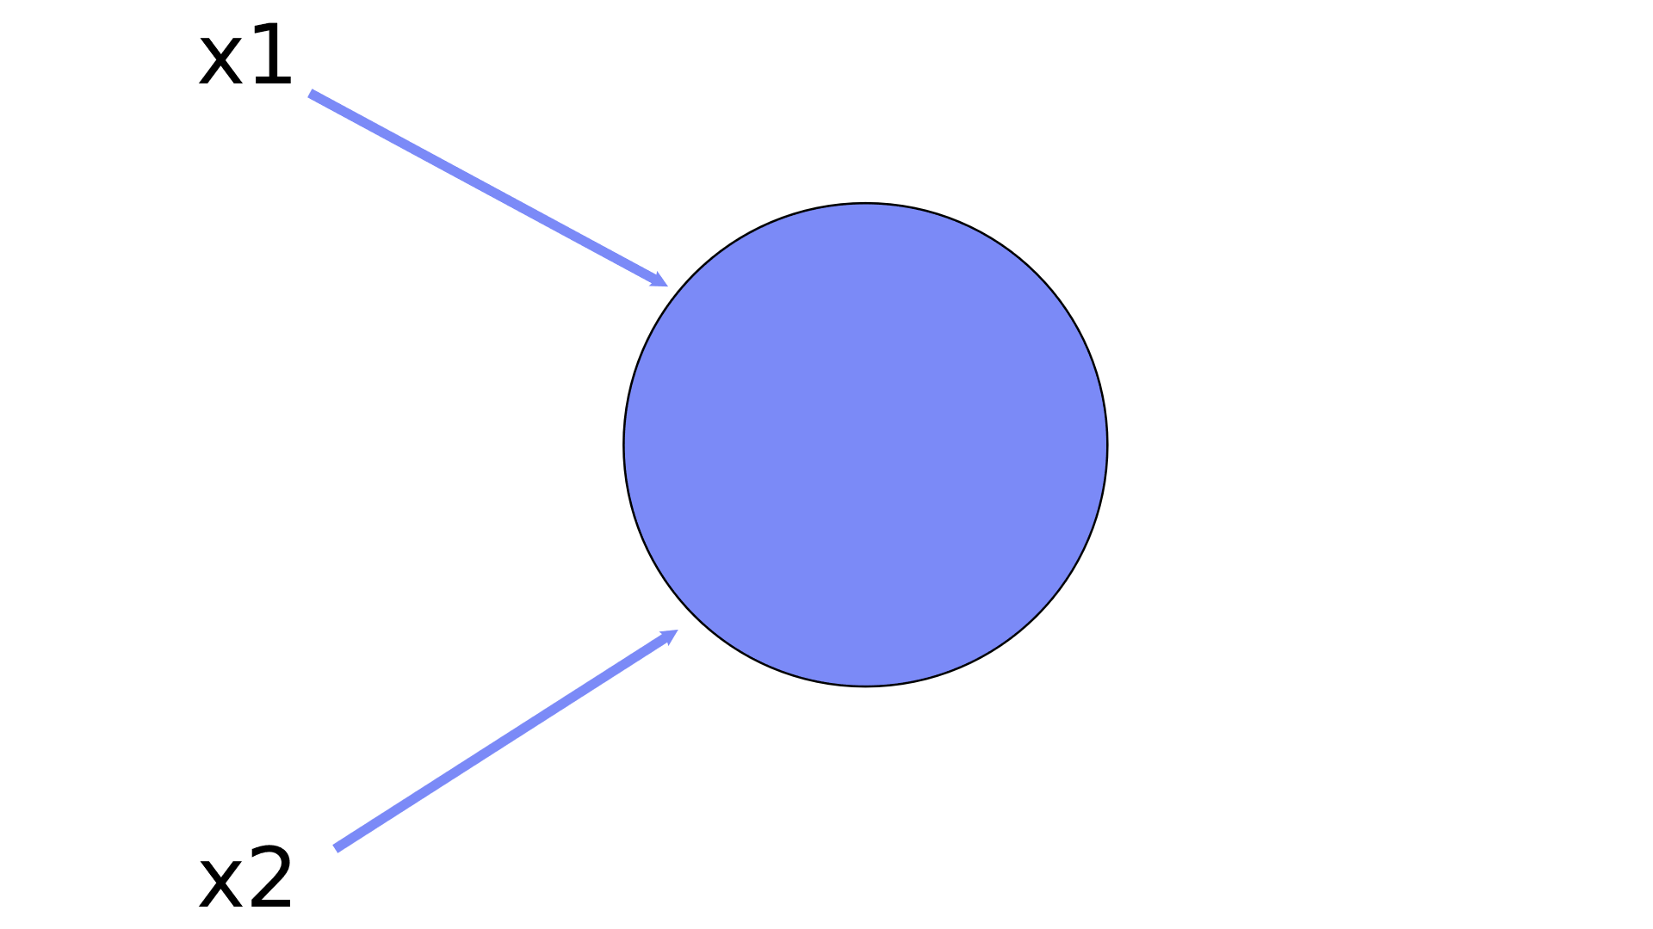
Data for your Neural Network
Your inputs:
Coffee shop (𝑥1) - 👍
Clubs (𝑥2) - 👎

Slide 13
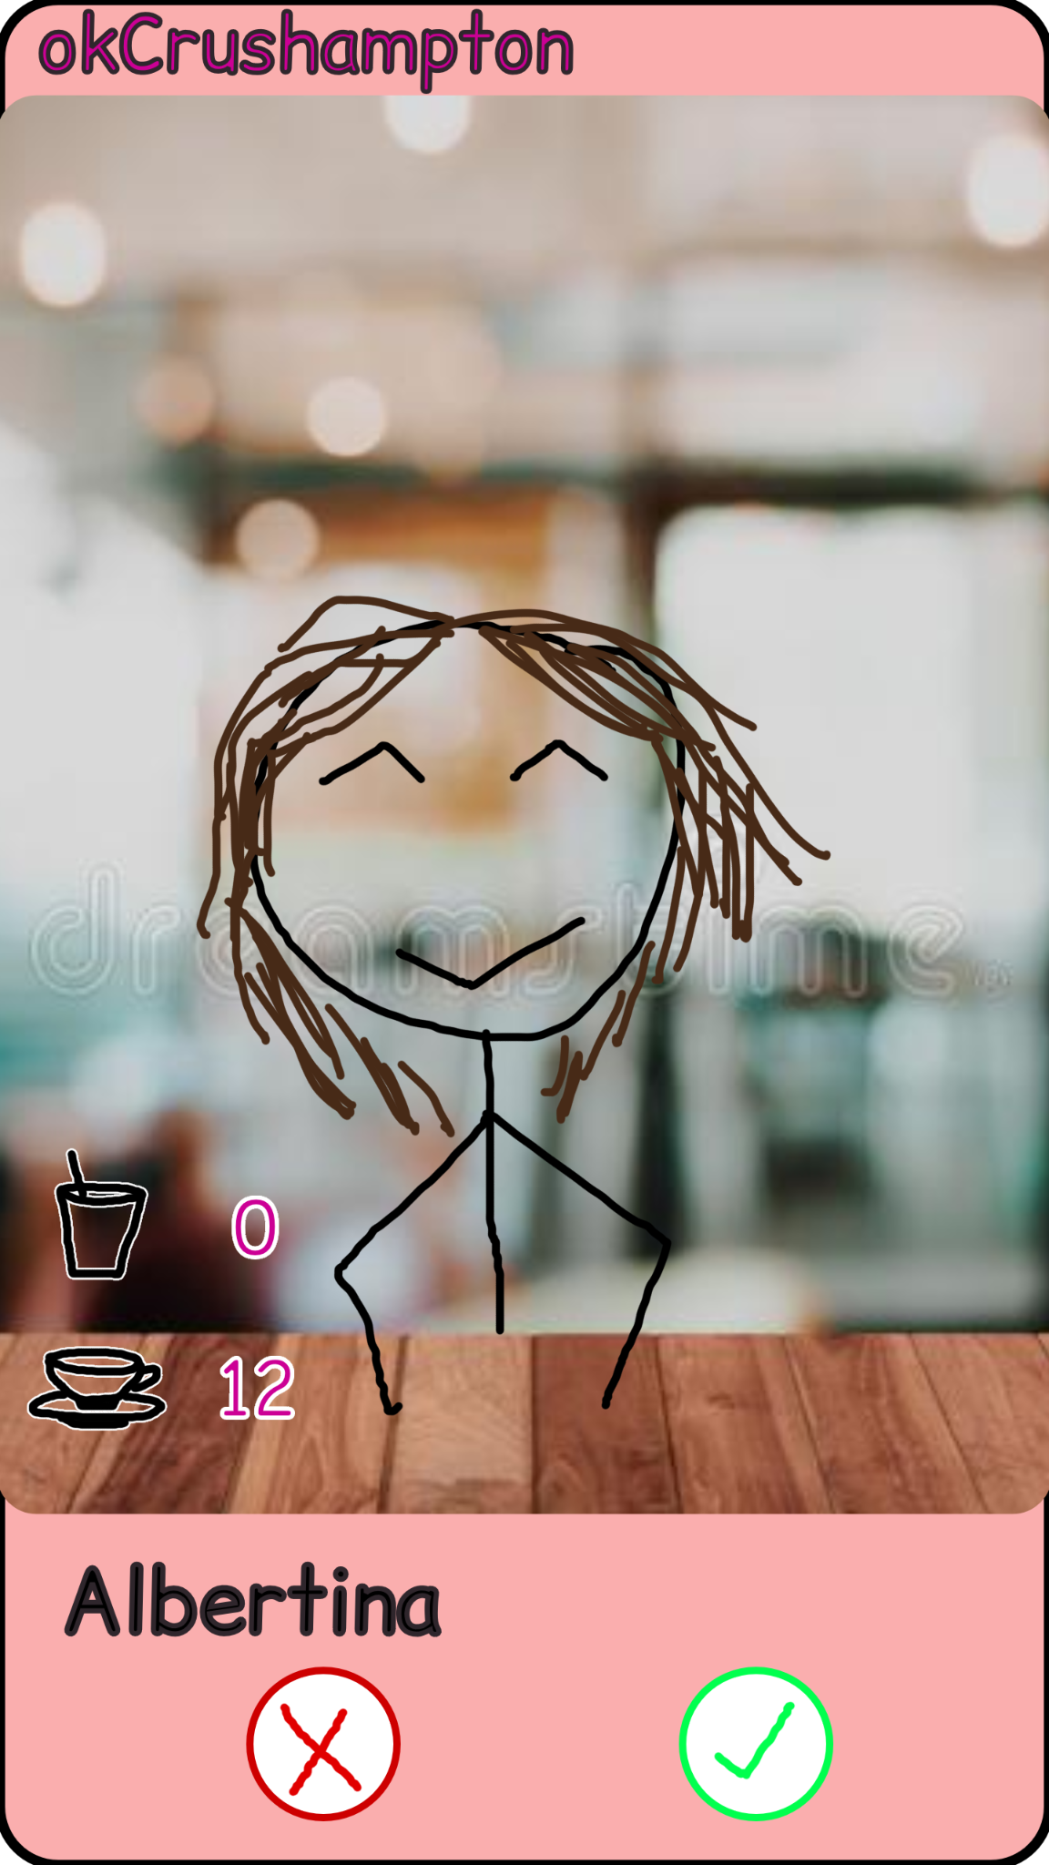
Our targets
Let’s say we came across a profile:
Coffee shop (𝑥1) = 5
Club (𝑥2) = 12
But we wanted someone like this:
Coffee shop (𝑥1) = 12
Club (𝑥2) = 0

Slide 14
Time to make a guess

Slide 15
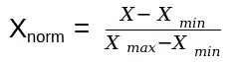
A very short detour through data processing
Let’s make the data a bit more easy for our Neural Network:
Data | Before | After
Coffee (𝑥1) | 5 | 0.167
Clubs (𝑥2) | 12 | 0.400
We use data normalisation to bring every data point to a range of [0,1]

Slide 16
Weighing our inputs
𝑥1 * w1
𝑥2 * w2

Slide 17
… and adding them
𝑥1 * w1
+
𝑥2 * w2

Slide 18
Results! (or is it?)
𝑥1 * w1
+
𝑥2 * w2
But that’s still X * w3
i.e : It’s still a linear multiplication
X is the vector from x1 and x2 (eg. [0.167 0.4]^{T} )

Slide 19
Avoiding linearity
If we had lots of weights and lots of input variables, it would still end up in all the weights summing up to one w value.
Compressed
Not detailed enough
Fruitless

Slide 20
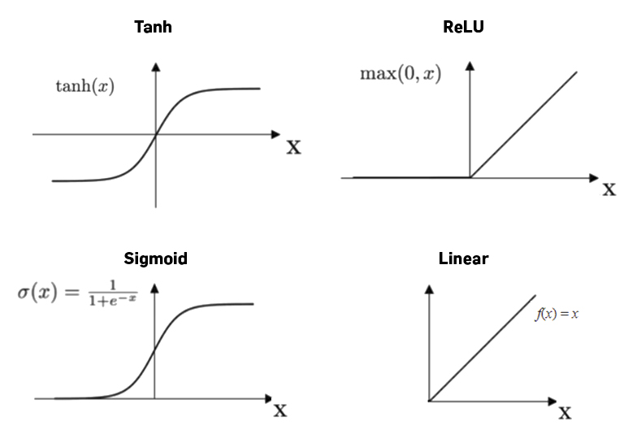
Enter the activation function
Let’s call it σ for now.
We’ll use sigmoid in our NN
https://machine-learning.paperspace.com/wiki/activation-function

Slide 21

Applying the activation function σ
𝑥1 * w1
+
𝑥2 * w2
σ

Slide 22
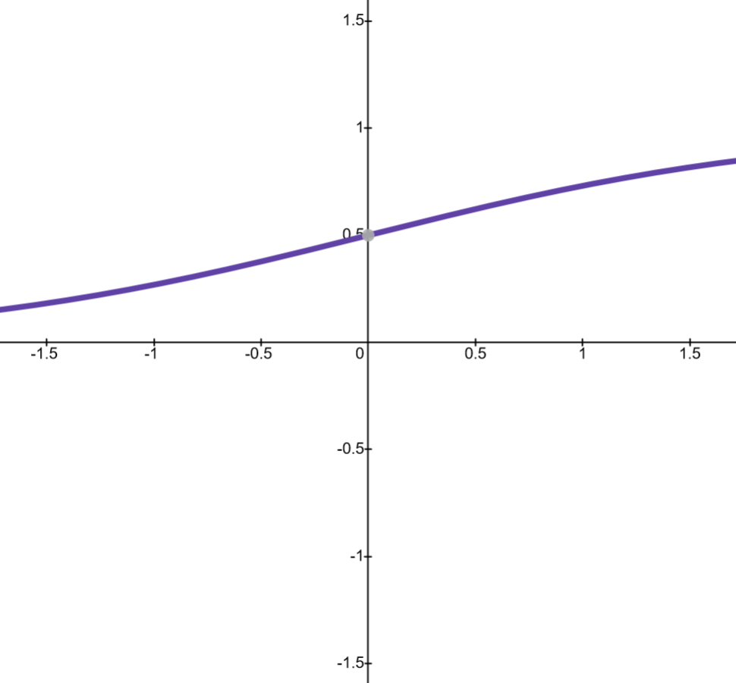
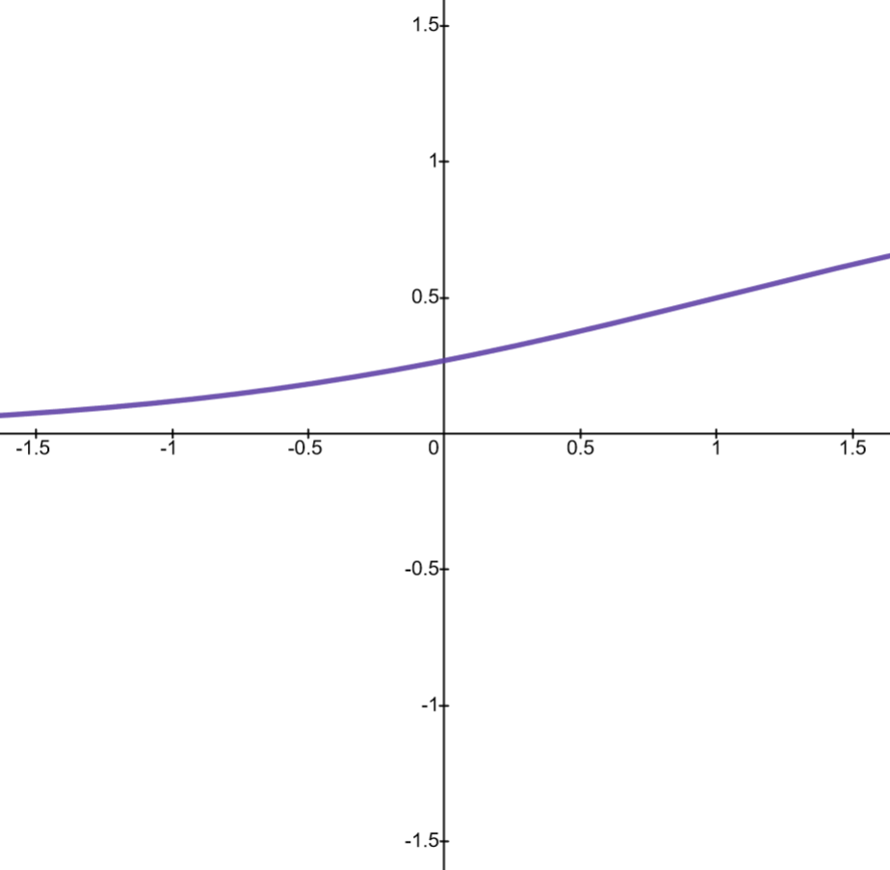
Except there’s now another problem.
Let this be our activation function:
What if we wanted it to activate only when it reached 1?
i.e this →

Slide 23
Except there’s now another problem.
Let this be our activation function:
Remember y = mx + c ?
It’s sort of like that

Slide 24
Thus we add a “bias” term or a constant term
𝑥1 * w1
+
𝑥2 * w2
+
b
σ

Slide 25
And now we have our first neuron!
𝑥1 * w1
+
𝑥2 * w2
+
b
σ

Slide 26
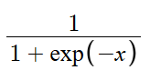
Time to actually make guesses
𝑥1 = 0.167
𝑥2 = 0.4
b = 1
w1 = 0.213
w2 = 0.63
σ (𝑥) =
𝑥1 * w1
+
𝑥2 * w2
+
b
σ
= 0.678
Remember, our weights are randomised when we initialise our Neural Network

Slide 27
A short look back
Let’s recap:
Configured our input data
Added weights
Added bias
Added an activation function

Slide 28
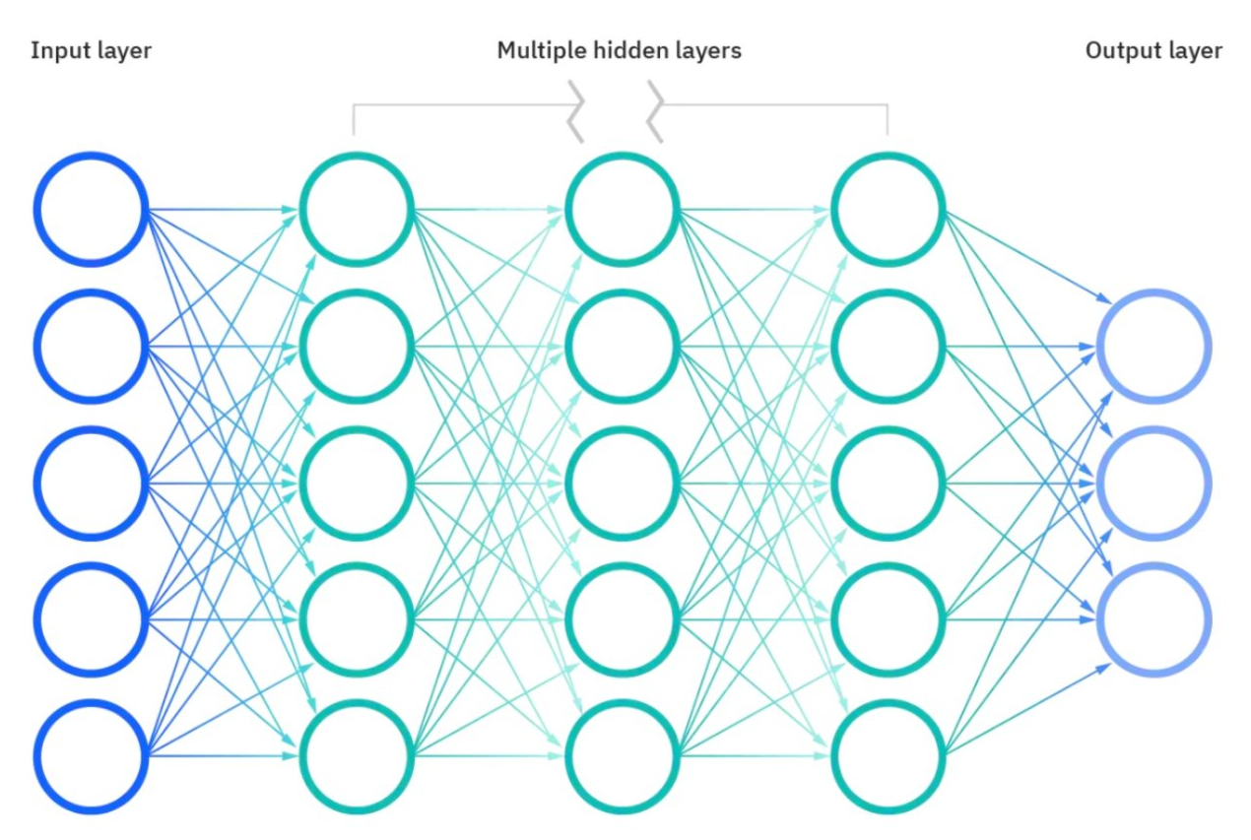
Neurons form the brain
Each Neuron has its own activation function, which we train.

Slide 29
NN says 0.678 or 67.8% chance of us liking them

Slide 30
But………

Slide 31
Time to train our Neural Network!
After this short break!

Slide 32
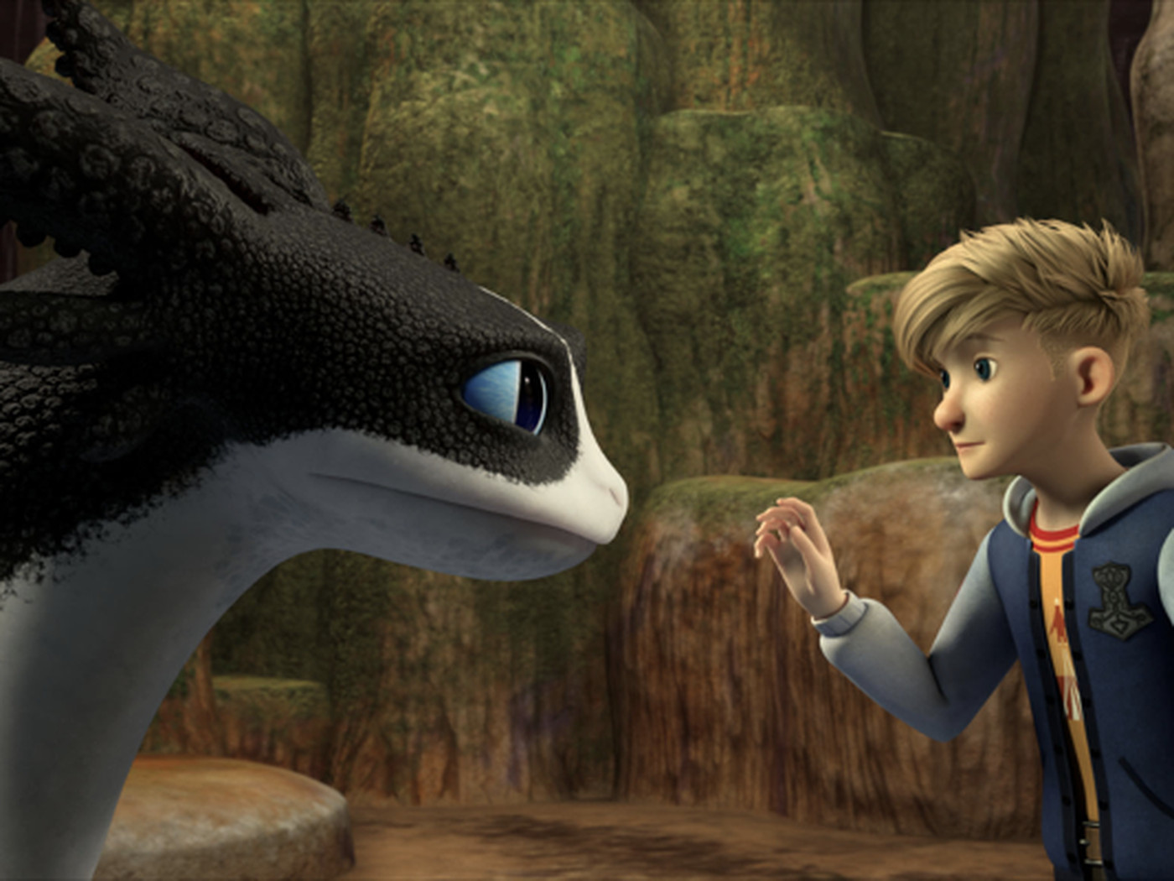
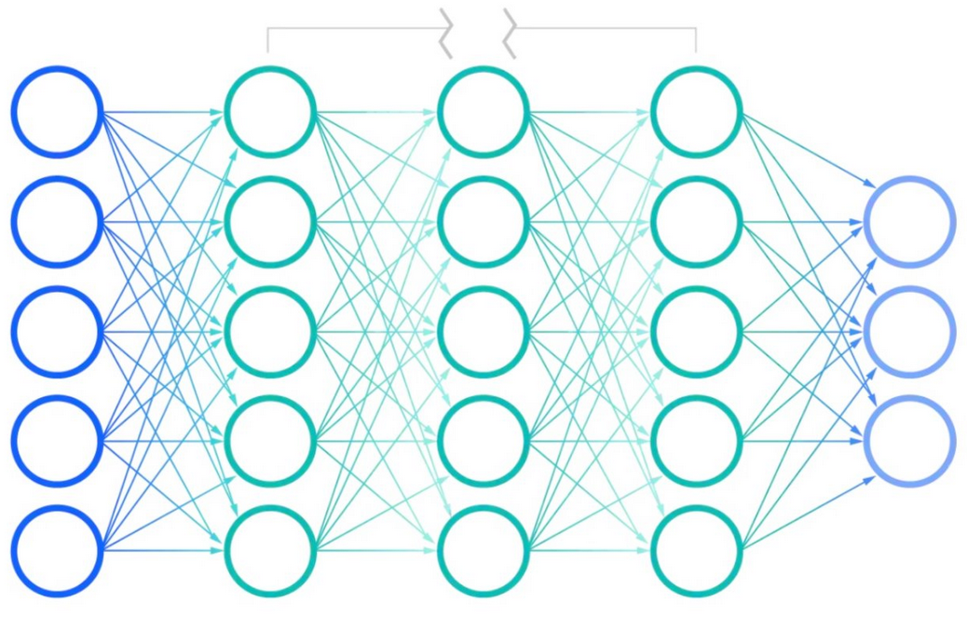
How to train your Neural Network
FYI: If this is not familiar, it’s because this is the spin-off version

Slide 33
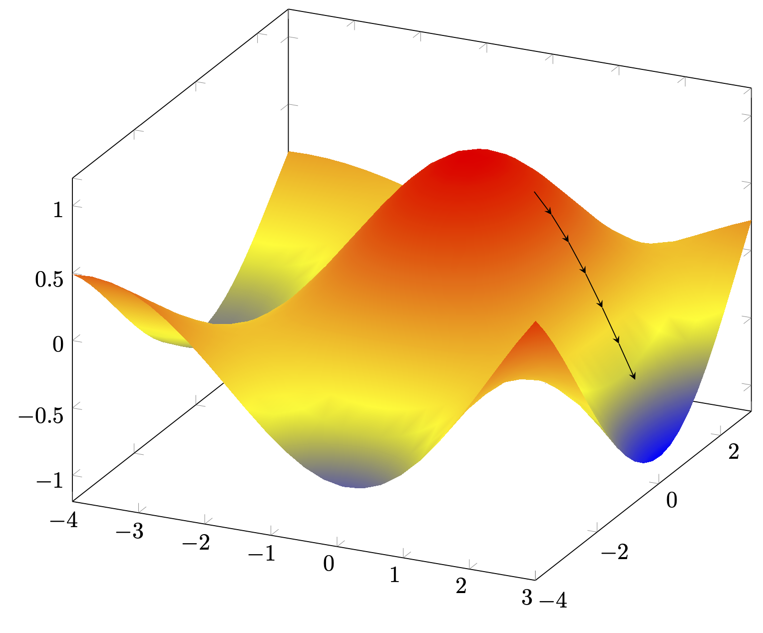
How far are we from desired output?
We need a function that tells us how far we are.
Function ideally needs to give us a slope that is continuous and we can find the lowest point on that slope
We call this the loss function

Slide 34
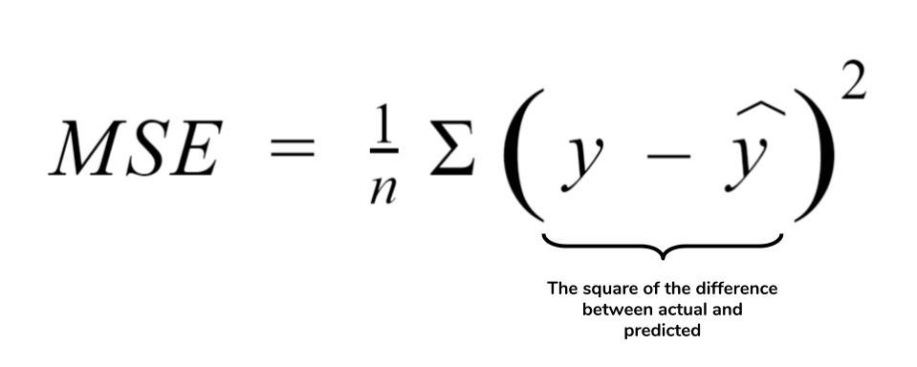
Loss function (One of many)
Many other loss functions out there!

Slide 35
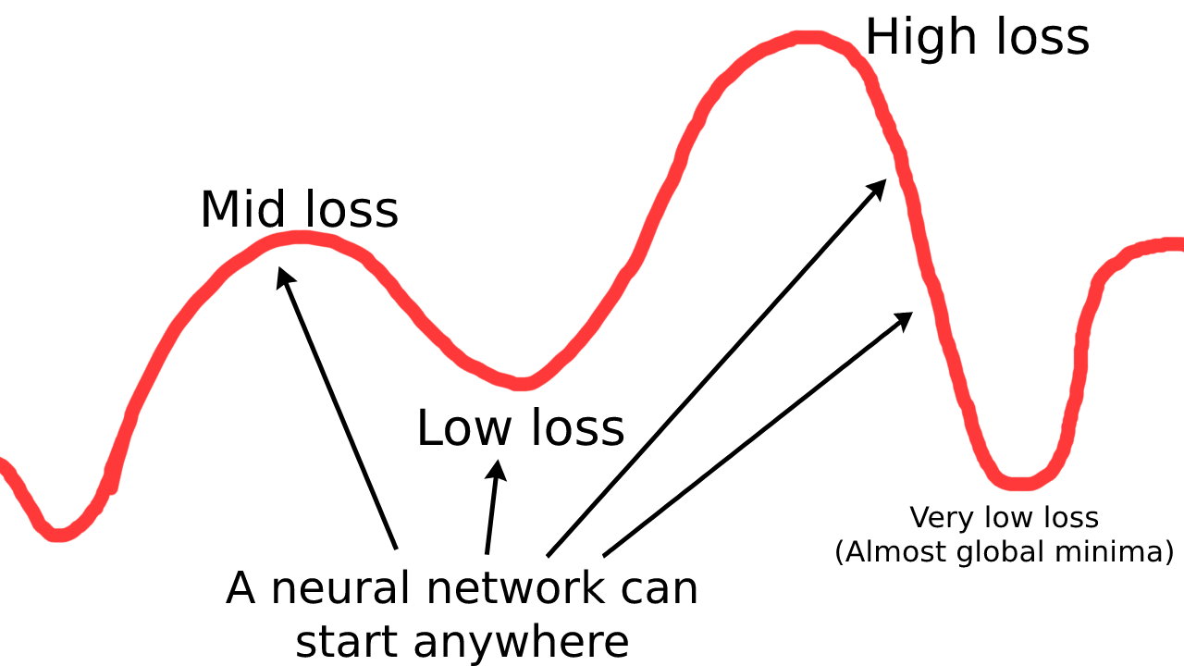
A lossy adventure

Slide 36
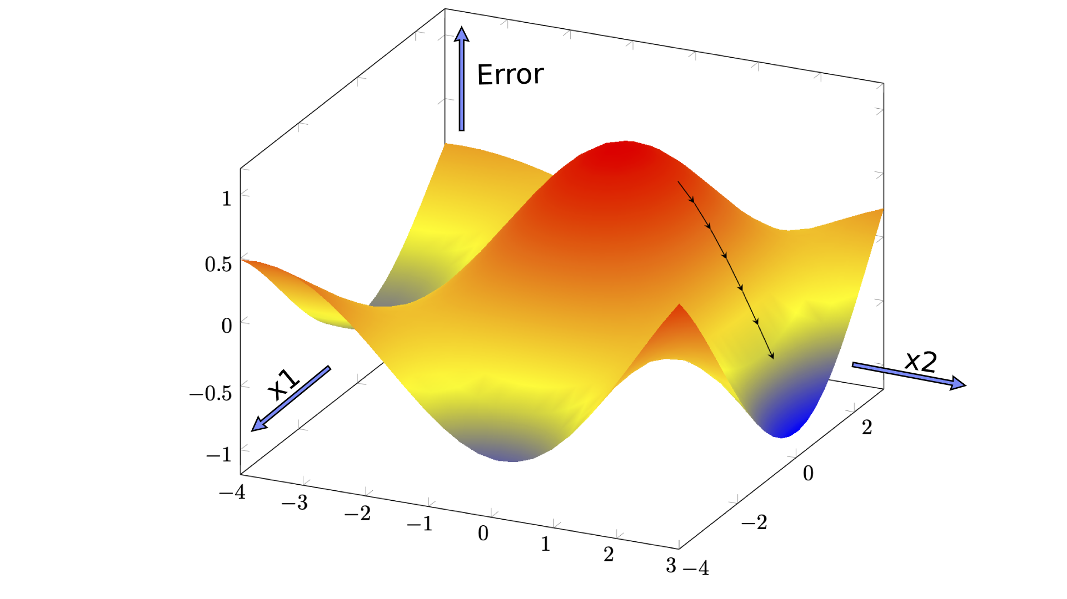
Gradually descending to the lowest point
We want to go from red to blue as that means lowest “error” rate in the Neural Network
Note: x1 and x2 aren’t normalised in this graph

Slide 37
Gradient Descent
Optimization algorithm for finding a local minimum of a differentiable function.
Repeated steps in the opposite direction of the gradient of the loss function
Loss function needs to be differentiable

Slide 38

Backpropagation Visualised

Slide 39
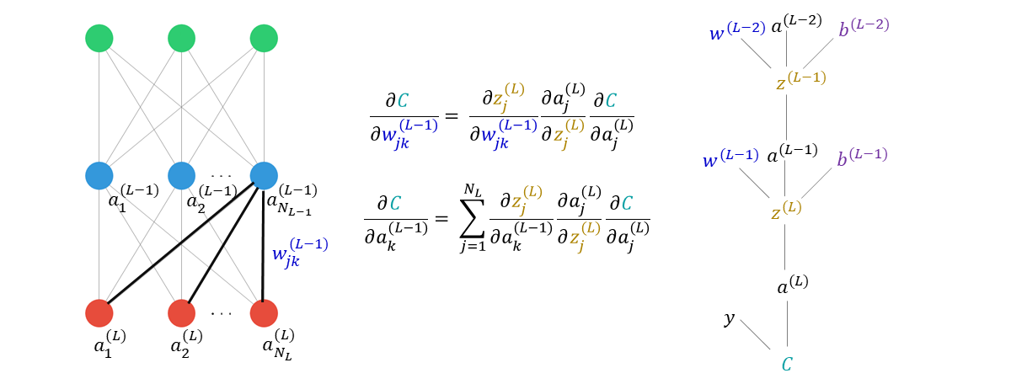
Backpropagation Math

Slide 40
Recap: The sequel
Loss function
Gradient Descent
Visualised them both
Backpropagation

Slide 41
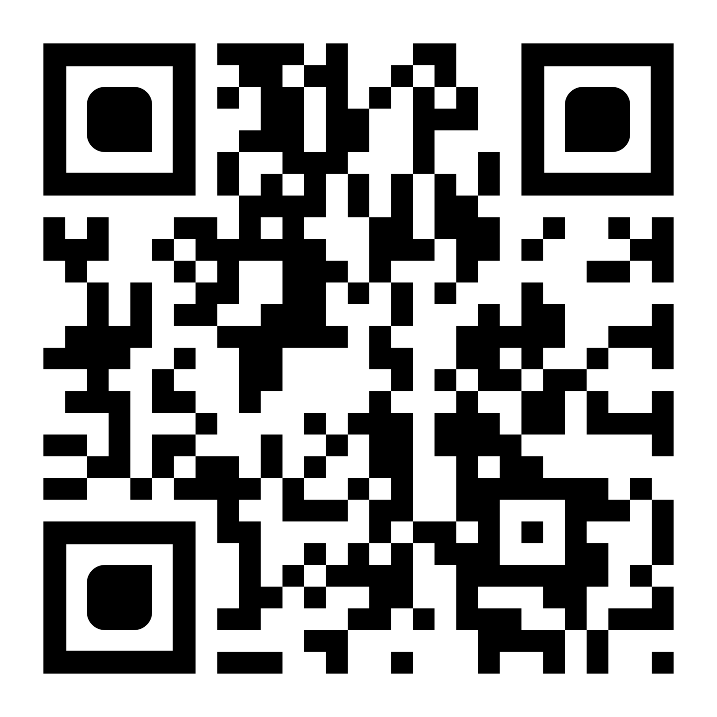
Further Reading!
http://aisoc.uk/articles/gradient-descent/
By Neeraja Menon

Slide 42
Bit of a history lesson
Neural networks implemented all the way in 1958
Marvin Minsky’s Perceptron caused a decline in Neural Network popularity
Backpropagation invented in the 1970s
Actually thought of as a Neural Network learning algorithm in 1986
Neural Network popularity shoots up again.

Slide 43

Have some fun yourself
https://nnplayground.com/
Change the training dataset to this!
[
[[1,1],[0.5]],
[[1,0],[1]],
[[0,1],[0]],
[[0,0],[0.2]]
]

Slide 44
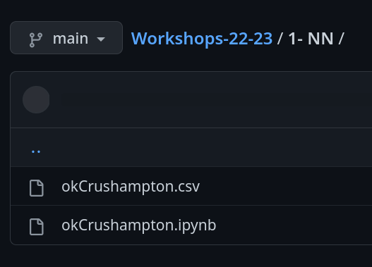
Coding time!
https://github.com/aisoc/Workshops-22-23/

Slide 45
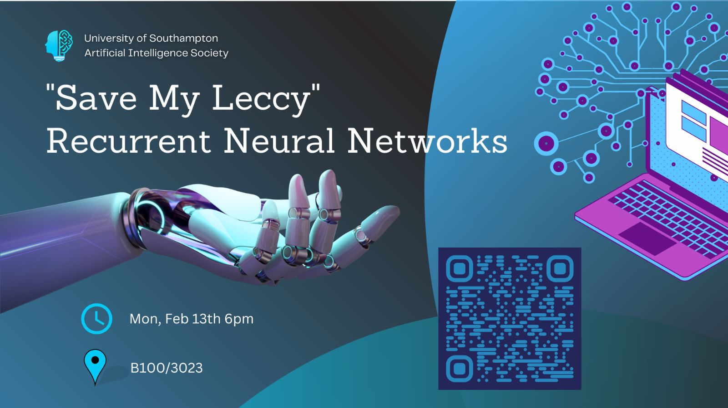
Next Session

Slide 46
Thank You!

